Slide 1
Streaming 2D Convolution Accelerator
By: Changwe Musonda, Kevin Wang, Emily Morales

Slide 2
Project overview
This project’s objective is to compare an FPGA A* implementation against a reference Python A* under identical maps, start/goal pairs, and heuristic settings. The FPGA core runs A* on a 16×16 occupancy grid with 8-directional moves and a Manhattan heuristic, reporting path length and cycle count for latency/speedup analysis versus Python. A lightweight Python 2D visualizer simply renders the FPGA testbench outputs to confirm correctness and make results easy to present.

Slide 3
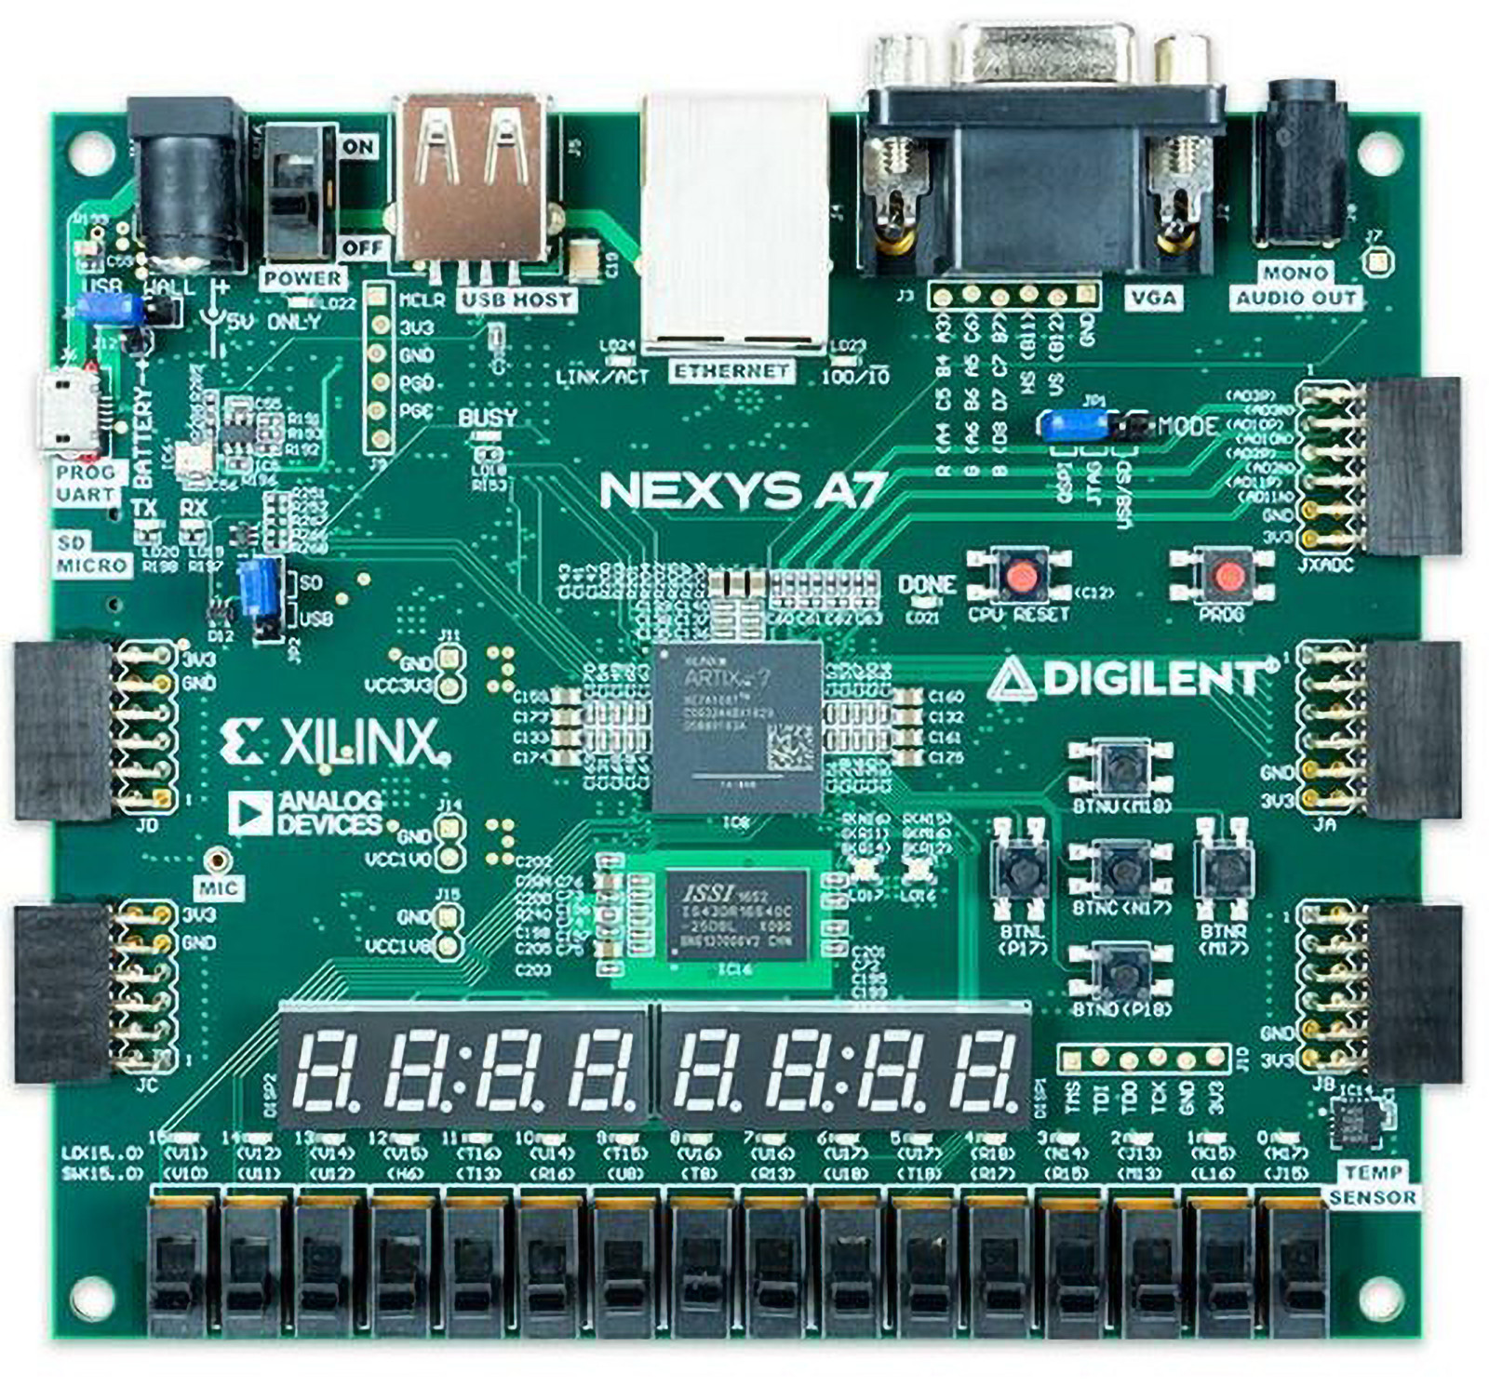
Hardware: Nexys A7

Slide 4
Project Roadmap and Deliverables
Company Name
Quarter
Month Year
Start: 10/27 |End: 11/14
Start: 10/27 | End: 11/14
Start: 11/14 | End: 11/21
Start: 11/21 | End: 11/23
Start: 11/23 | End: 12/1
Verilog Code
Python Code
Testing
Comparing
Results/Findings
We will implement the line buffers, the sliding window generator, and the fixed-point MAC pipeline, including frame/line valid control, then smoke-test the datapath in simulation.
We will build the image I/O, a golden floating-/integer-precision convolution, and a visualizer so both hardware and software flows can run and produce comparable outputs.
We will sweep multiple kernels and images, verify border handling, quantify fixed-point error against the golden model, and check that the stream never stalls.
We will compare hardware and software results, highlighting image quality (e.g., PSNR), latency, resource use, and any differences in edge cases.
We will decide which execution path is preferable for our constraints, record the findings, and finalize plots, tables, and the demo materials.

Slide 5
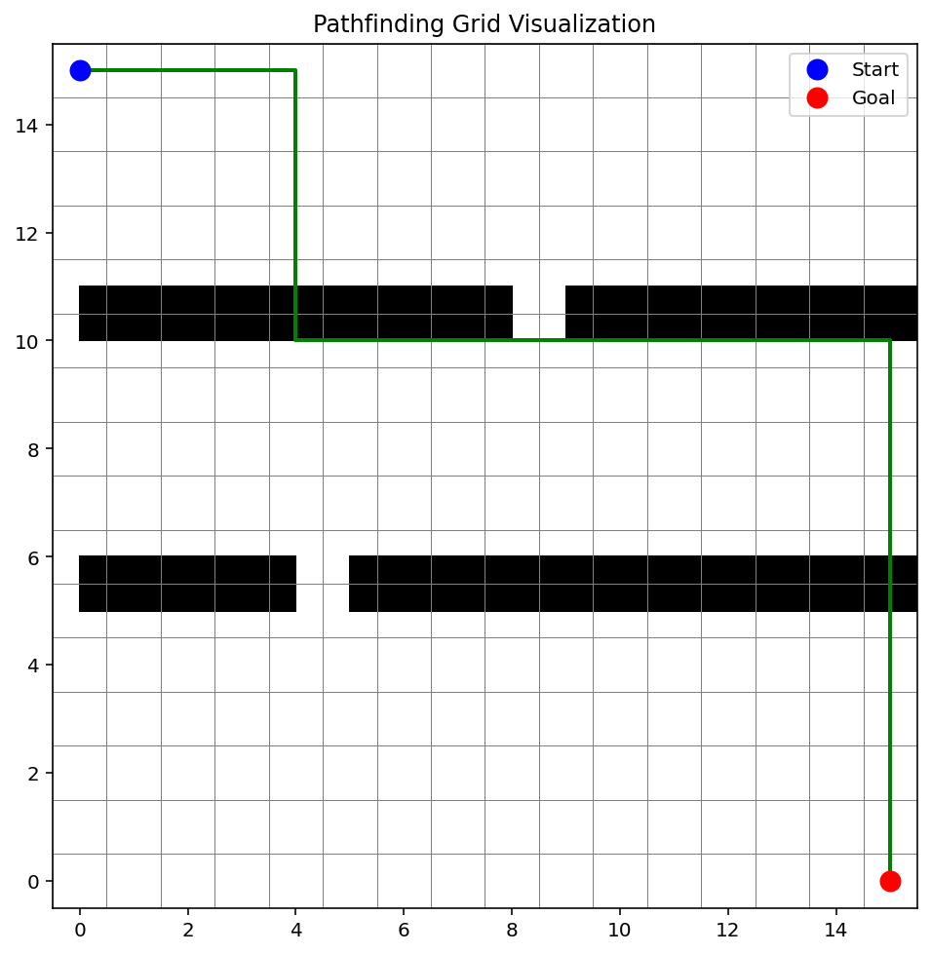
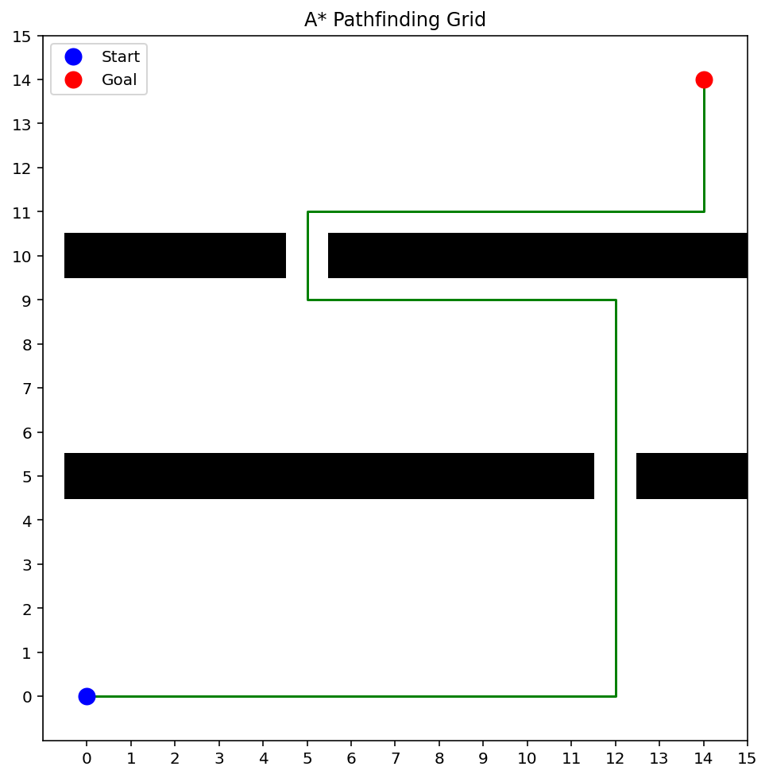
Example/Progress

Slide 6
Final Report Plan
KEY LEARNING 1
When the FPGA and Python A* use the same 4-connected moves, Manhattan heuristic, costs, and tie-break rules, they produce the same path and path length.
KEY LEARNING 2
Keeping data on-chip and doing simple operations each cycle lets the FPGA cut latency (cycles) versus Python; the open-set design sets how well this scales to bigger grids.
KEY LEARNING 3
The Python 2D visualizer confirms the FPGA path matches Python on each map, while the reported cycle count and path length make the speedup and correctness easy to judge.

Slide 7
Any questions? Ask away!

Slide 8
Thank you
Company Name
Quarter
Month Year

